Slide 1
MUST AVERAGES HAPPEN?
57 students, average score in an exam 73.25.
Must one students have scored 73.25?
What goes up must come down. OK, but …
must the velocity become 0 sometimes?
Takes me two hours to go to Chicago, 90 miles away.
Must I have gone at 45 miles/hour sometime?
A better story: Police car no. 1, standing at mile 77 (the South Bend/Notre Dame exit) at 14:45 sees a Maserati Gran Turismo going by westbound at 55 mph.
Notes:
, …

Slide 2

The speed limit on the Indiana Toll Road is 70 mph. Police car no. 1 calls Police car no. 2, standing at mile 50 (the LaPorte exit, 27 miles west of mile 77) and tells them to be on the lookout for that gorgeous Maserati. (A $250,000 car.)
At 15:00 Police car no. 2 radios no. 1 saying they just saw the Maserati go by. Car no. 1 radios back, “Stop him, he broke the speed limit !”
How did Police car no 1. know?

Slide 3
Our brain gives different answers in the four situations presented:
NO, no student must have scored the average, but …
YES, the stone must eventually hit velocity 0
YES, I must have gone at 45 mph somewhere between here and Chicago and …
YES, the Maserati broke the speed limit because …
The difference is that in the exam case we have a finite (discrete) collection of data;
In the other three we have a continuous set of data (actually, just to teach you another word, intervals of real numbers have a property called
“completeness” that our brain senses and makes us give correct answers)

Slide 4
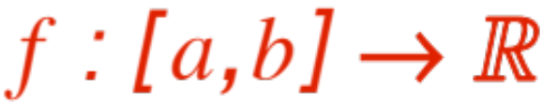
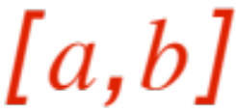
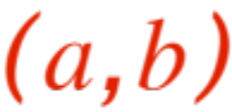
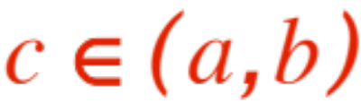
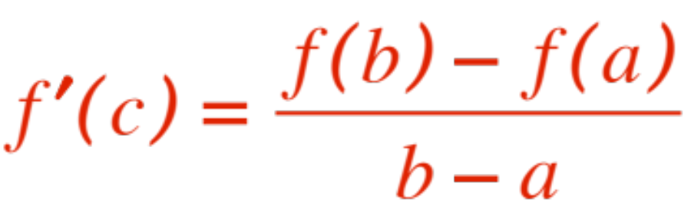
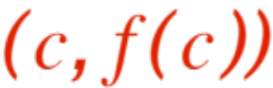
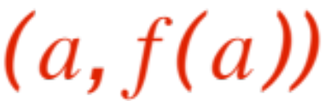
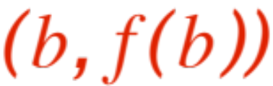
The main result, which our brain senses, is the following statement (Mean Value Theorem)
Theorem. Let be
Continuous on and
Differentiable on .
Then for some
Note: this says that the tangent line at
Is parallel to the secant joining and

Slide 5
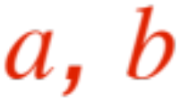
When faced with a statement like our theorem,
Inquiring minds want to know ……
What?
Are those two conditions really needed to guarantee the conclusion?
The answer is YES, absolutely !
Let’s deny 1 (and keep 2). Trouble is that 2 implies continuity on , so we can only break continuity at either (or both) end-points
.
Here is a figure that does it for us.

Slide 6
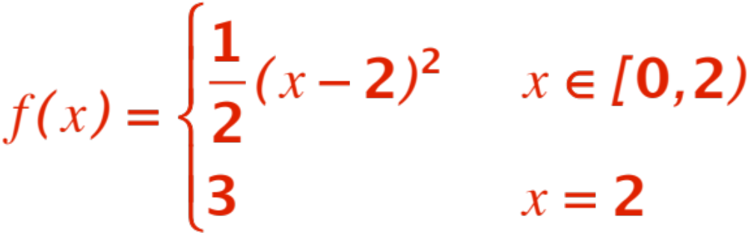
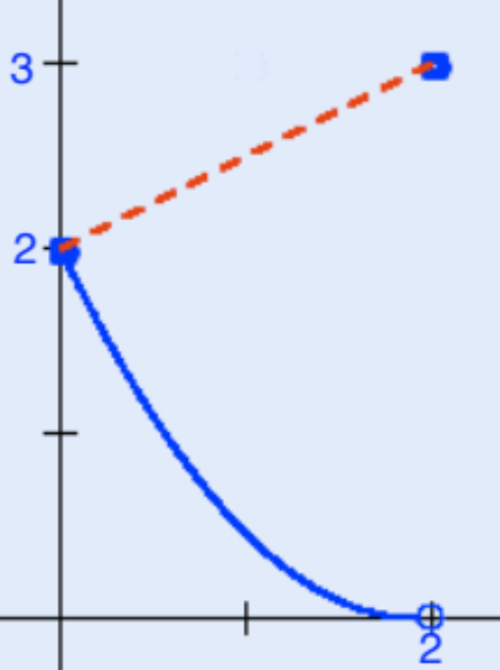
The function is:
and its graph is

Slide 7


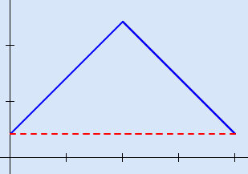
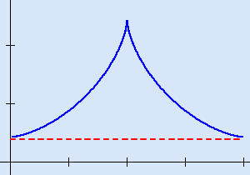
The secant has slope , but all tangents have slope !
Therefore condition 1 is absolutely needed.
To see that condition 2 is also needed, draw a picture of a roof, or of a cusp and look: the secant has slope 0, all tangents (where they exist) have non-zero slopes.

Slide 8
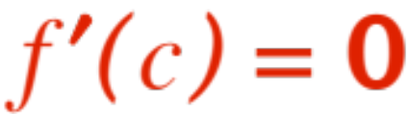
Having satisfied our inquiring minds, we proceed with the proof.
Following tradition (and the textbook !) we look first at the case when the secant is horizontal. This is known as Rolle’s theorem; besides being relatively easy to prove and acknowledging Rolle’s contribution to mathematics, the general case will (couldn’t resist the pun !) roll right out.
So, we have to show that, under conditions 1 and 2, if the secant is horizontal then for
some .

Slide 9
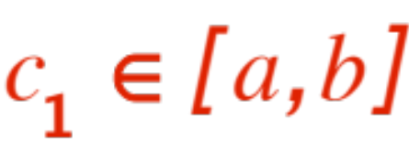
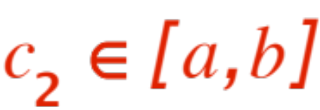




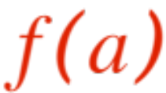
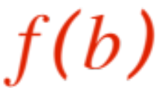

From condition 1 (and the Extreme Value Theo-rem) we get that there are two points
and where achieves its max-imum and minimum. If either or are
inside the open interval we are done, the derivative exists there, and is therefore . But if both and are end-points, then
and are both maxima and minima of the function, that is
the function is a constant!, there are as many
‘s as one wants ! Rolle’s is proved.

Slide 10
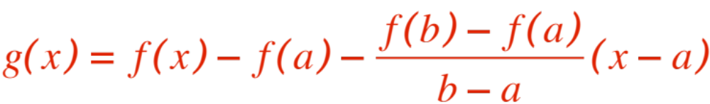


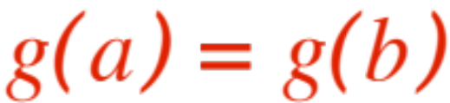
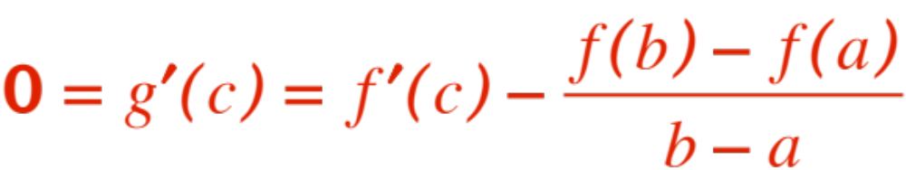
The general case follows from Rolle’s theorem through a bit of algebraic magic. We define a new function
and observe that it satisfies the hypotheses of Rolle’s theorem, that is
is differentiable on and
continuous on and
(check it out !) Therefore, for some
QED

Slide 11
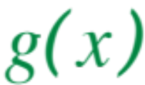
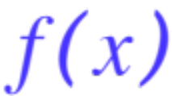
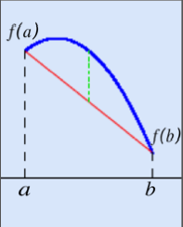
Remark. The bit of “algebraic magic” is not so
… magical ! The figure below shows that the function is just the (vertical) distance
between and the secant

Slide 12


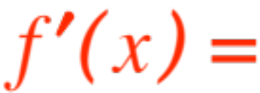

This remarkable, beautiful theorem is very help-ful in catching speeding Maserati Gran Turismo’s, it essentially assures us that the computed aver-age (in the continuous case)
DOES HAPPEN !
Like many other existence theorems in Mathe-matics (there exists a …) it does not tell us how to actually find that !
But in the case of the MVT it is actually easy to find all those ‘s ! Set
slope of secant, and solve for .

Slide 13
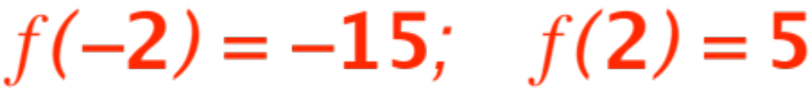

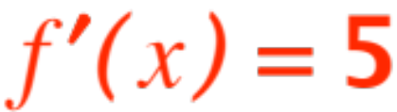
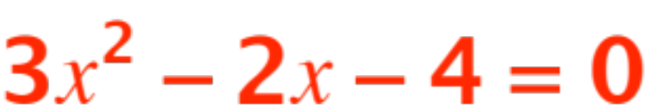
Here is an example, without figure.
Find all the values of that satisfy the MVT for the function
Aswer. The function is continuous and differentiable over the given interval, therefore the MVT applies. We have:
Therefore the slope of the secant is .
The equation becomes

Slide 14
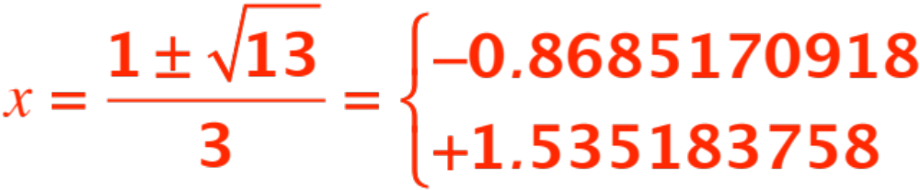
that has solutions
So in this example there are two tangents that are parallel to the secant.
Now do some more from the textbook.

